Slide 1


Beyond the Needle: Attention-Based Multimodal Deep Learning for Anemia Screening Through Ablation Studies and Comparative Benchmarking
(Group: G4)
Team AI Goriber Genie
Jasmin Sultana Shimu (0112230353)
Sayma Sultana (0112230948)
Md Fazley Rabbi (0112230944)
Tasmim Jahan Rimvy (0112230846)
Supervisor Name: Dr. Jannatun Noor Mukta
Co-Supervisor Name: Khushunur Binte Jahangir

Slide 2
Table of Content
1. Introduction
1.1 Why Explore Non-Invasive Anemia Screening?
1.2 What Remains Unresolved in Previous Research?
1.3 Research Objectives and Key Contributions
2. Methodology
2.1 Multimodal Dataset & Preprocessing Framework
2.2 Ablation Study Design and Experimental Configurations
2.3 Our Model Architecture
2.4 How Did Our Models Compare with Existing Approaches?
3. Results and Discussion
3.1 Ablation Study Results and Performance Analysis
3.2 Experimental Results and Performance Analysis
3.3 Interpreting the Experimental Findings
4. Conclusion
4.1 Conclusions and Research Implications
4.2 Limitations of This Study
4.3 Future Work
References
2

Slide 3

1. Introduction
3

Slide 4
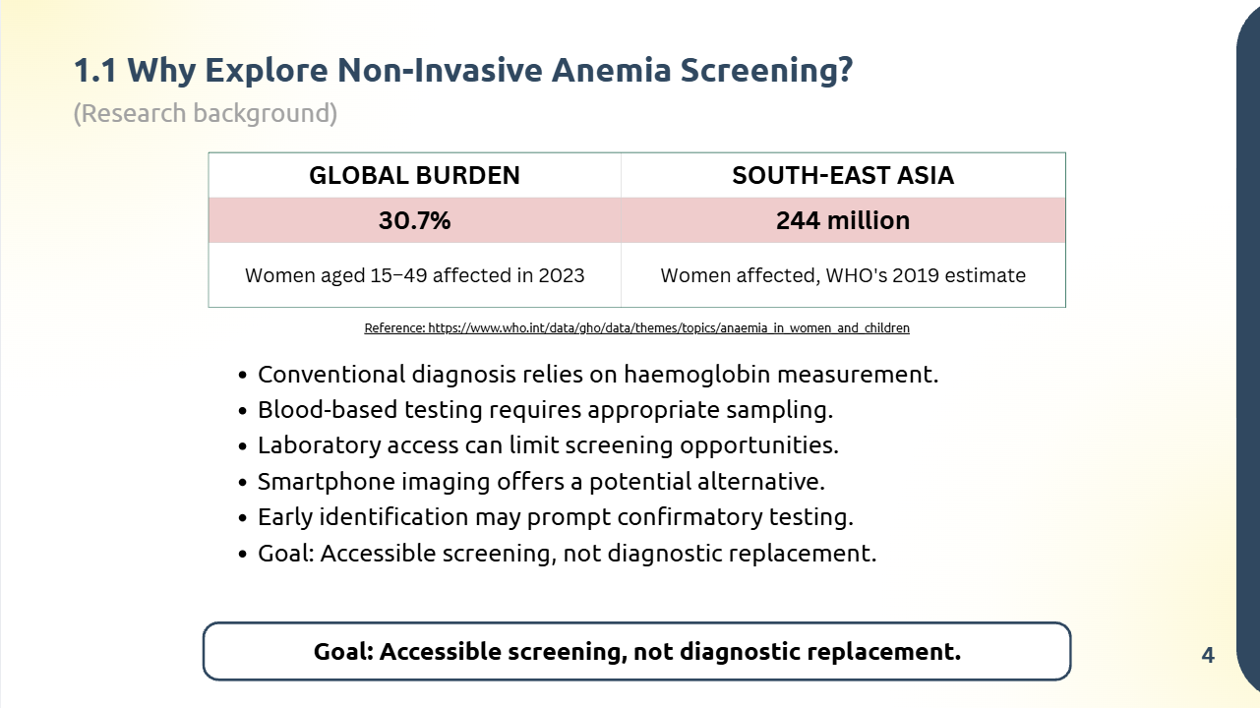

Slide 5
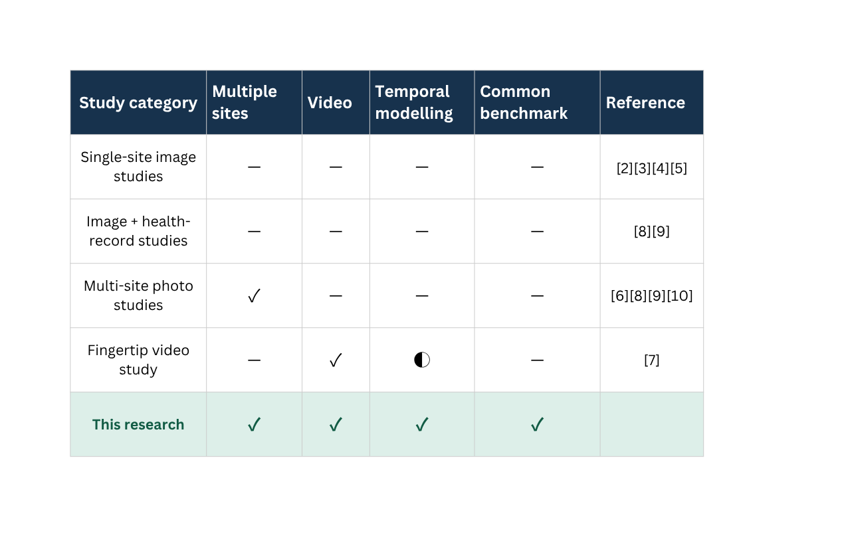
1.2 What Remains Unresolved in Previous Research?
(Literature review)
  Most studies use only one body site, such as nails or eyes [2][3][4][5].
  Most studies use still photos, while only a limited number have explored video-based approaches, such as fingertip video for non-invasive hemoglobin estimation [7].
  Although some studies have examined multiple body sites, methods for jointly combining information across sites remain limited and need further investigation [2][3].
  Studies use different data, splits and goals, so results are hard to compare [2][6][7][11].
  Most studies only predict “anemic” or “not anemic”, not severity [2][6][11].
  Many studies use small datasets of about 100 to 200 samples [3][7][11]. Few were tested in a real clinic [8].
✓ Addressed | ◐ Partially addressed | — Not addressed
5

Slide 6
1.3 Research Objectives and Key Contributions
(Research Objectives and Contributions)
Research Objectives
Key Contributions
  Build one model that uses three body sites: fingertip video, palm video and nail photo.
  Compare two ways to handle video frames: mean pooling and BiLSTM.
  Compare two ways to join the three sites: concatenation and self-attention.
  Test if age, sex and symptom data help.
  Compare our model with 11 published methods.
  Test everything with five-fold cross-validation.
  We combined fingertip video, palm video and nail photo in one model.
  We tested each design choice one at a time (ablation study).
  We re-ran 11 published methods on the same dataset for a fair comparison.
  We found one unreliable experiment and left it out of the results.
  We show clearly what works, what does not, and where the model still fails.
6

Slide 7
2. Methodology
7

Slide 8
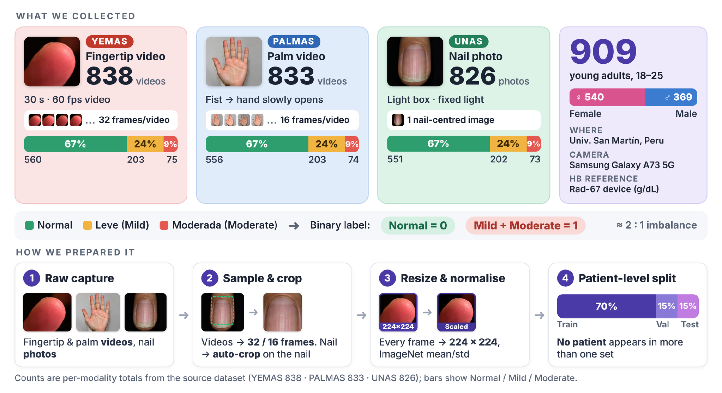
2.1 Multimodal Dataset & Preprocessing Framework
(Dataset Information)
8

Slide 9
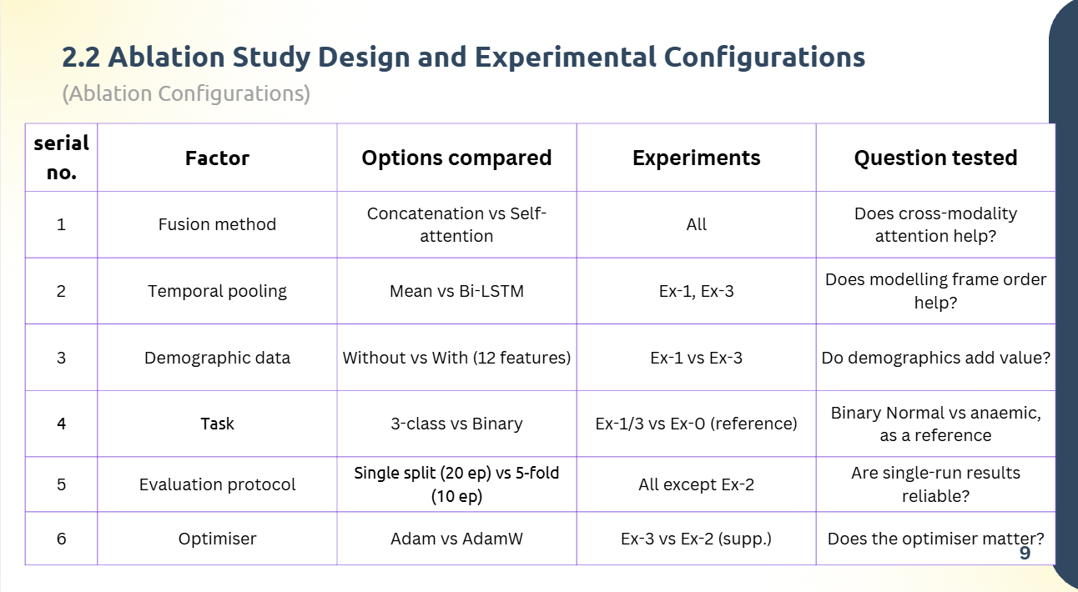

Slide 10
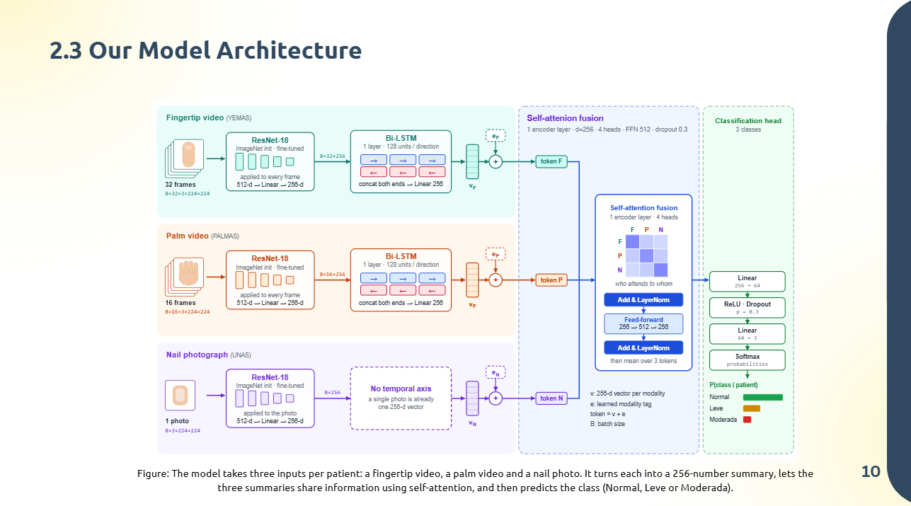

Slide 11
2.4 How Did Our Models Compare with Existing Approaches?
(Benchmarking)
Goal: Compare our reference model with 11 published methods on the same dataset and the same three-class task (Normal, Leve, Moderate).
Why re-implement them
  Published papers use different datasets, labels and tests.
  So their accuracies cannot be compared fairly.
  We re-ran each method on our dataset, with the same three classes.
Evaluation protocols
  B03-B08: five-fold on the same fixed test set as our model (123 participants), so they compare directly.
  B13: five-fold CV over all nail participants, indicative only.
  B09-B12: single runs on their own splits, descriptive only.
Metrics: macro-F1 (main), macro-AUC, per-class F1 and confusion matrices. Macro-F1 is the main metric because always predicting Normal already gives 0.707 accuracy.
11

Slide 12
  Results
and
Discussion
12

Slide 13
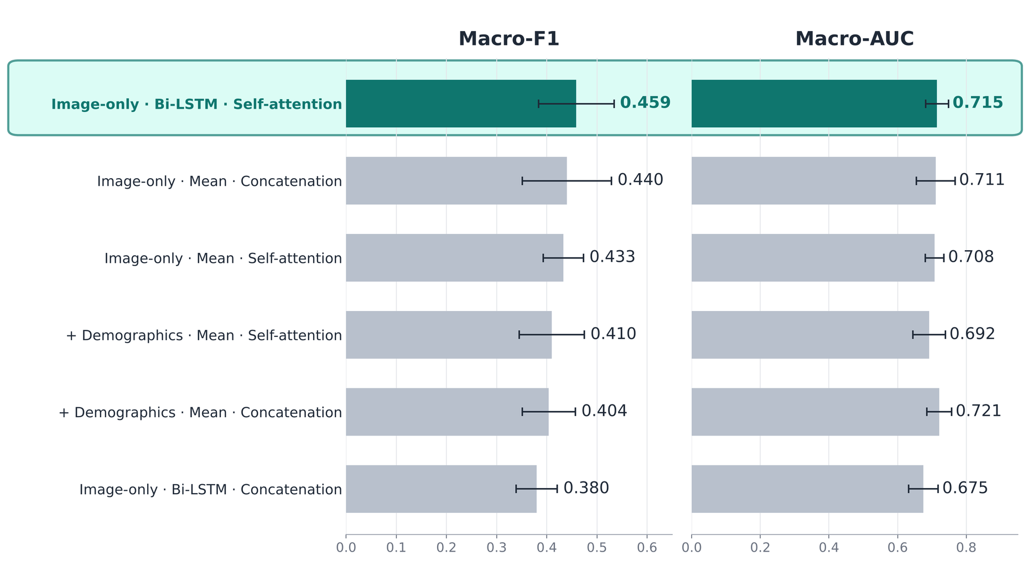
3.1 Ablation Study Results and Performance Analysis
(Ablation results)
Figure 2. Ablation results (5-fold CV, mean ± SD). The highlighted configuration performs best.
13

Slide 14
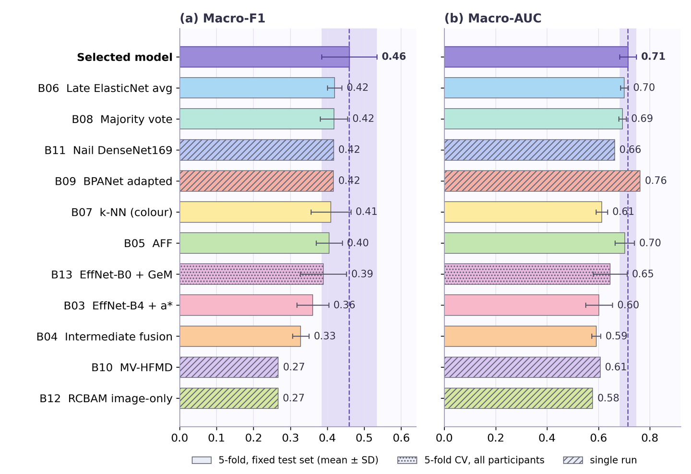
3.2 Experimental Results and Performance Analysis
(Bench-marking Results)
14

Slide 15
3.3 Interpreting the Experimental Findings
(Discussion)
What we found
What the ablation showed
  Fingertip, palm and nail recordings contain a detectable signal for anemia.
  Best single modalities: fingertip 73.87%, nail 67.27%, palm 67.20% accuracy.
  Fusion models reached macro-F1 0.380 to 0.459, close to the 0.407 of a tabular logistic regression.
  Self-attention was not shown to be better than concatenation.
  BiLSTM pooling had no consistent effect.
  Demographic and symptom variables did not help.
15

Slide 16
3.3 Interpreting the Experimental Findings
(Discussion)
How we compare with existing methods
What it means
  Our model had the highest macro-F1 of 11 published methods.
  Seven methods were within one SD, so it is effectively a tie.
  Methods differ mainly in sensitivity vs. specificity.
  Our model is competitive, not clearly better.
  It finds only 1 of 7 Moderate cases (sensitivity 0.39).
  It is not ready for stand-alone clinical screening.
16

Slide 17
  Conclusion
17

Slide 18
4.1 Conclusions and Research Implications
(Conclusions)
  The signal is real: fingertip, palm and nail recordings all carry a detectable anemia signal.
  Fingertip video is strongest: it reached 73.87% accuracy with 32 frames and augmentation. Nail reached 67.27% and palm 67.20%.
  Fusion did not clearly help: six fair configurations scored macro-F1 0.380 to 0.459, close to the 0.407 of demographics alone.
  No design choice mattered consistently: self-attention, BiLSTM pooling and demographics showed no reliable benefit.
  Competitive, not superior: our model had the highest macro-F1 of 11 published methods (0.459), but seven were within one SD.
  Not clinically ready: it finds only 1 of 7 Moderate cases (sensitivity 0.39).
18

Slide 19
4.2 Limitations of This Study
Limitations
  We used data from one site only. All 909 participants were aged 18 to 25.
  There were no severe anemia cases.
  The test set had only seven Moderate cases. This makes recall and comparisons less reliable.
  Our model found only 1 of 7 Moderate cases (sensitivity 0.39).
  Not all 11 methods were tested the same way. Some had five-fold tests, some a single run.
19

Slide 20
4.3 Future Work
  Collect data from more places, more devices and more age groups.
  Include more Moderate and Severe cases.
  Compare predictions with laboratory hemoglobin tests.
  Improve detection of Moderate cases.
  Run repeated cross-validation, several random seeds and statistical tests.
  Test all 11 methods under the same rules, with the same tuning.
20

Slide 21
References
Research paper:
https://revistas.unsm.edu.pe/index.php/rcsi/article/view/955
https://drive.google.com/drive/folders/1ztGpMMw0ni_VLqL353Ju34Kvw3WTmTye
Dataset Drive link:
  [1] E.-T. Lin, S.-C. Lu, A.-S. Liu, C.-H. Ko, C.-H. Huang, C.-L. Tsai, and L.-C. Fu, “Deep Learning-Based Model for Non-invasive Hemoglobin Estimation via Body Parts Images: A Retrospective Analysis and a Prospective Emergency Department Study,” Journal of Imaging Informatics in Medicine, vol. 38, no. 2, pp. 775–792, 2025, doi: 10.1007/s10278-024-01209-4.
  [2] P. Appiahene, J. W. Asare, E. T. Donkoh, G. Dimauro, and R. Maglietta, “Detection of iron deficiency anemia by medical images: A comparative study of machine learning algorithms,” BioData Mining, vol. 16, art. no. 2, 2023, doi: 10.1186/s13040-023-00319-z.
  [3] S. Mythili, R. A. Chelsia, and M. Thirishaa, “Anaemia Detection using Deep Learning by processing Conjunctiva, Fingernails, Palm and Tongue Images,” International Research Journal on Advanced Engineering Hub (IRJAEH), vol. 2, no. 9, pp. 2433–2439, 2024, doi: 10.47392/IRJAEH.2024.0333.
  [4] K. Kumar, A. Gupta, N. Gupta, M. Asim, and S. Srivastava, “Non-Invasive Hemoglobin Prediction: A Machine Learning Approach,” in Proceedings of the 2025 5th International Conference on Advancement in Electronics & Communication Engineering (AECE), 2025, pp. 620–625, doi: 10.1109/AECE67531.2025.11386530.
  [5] S. Krithika, A. K. R. Poreddy, T. Balakrishna, and P. Kokil, “A Multi-input Deep Neural Network Framework for Non-invasive Detection of Anemia using Finger Nail Images,” in Proceedings of the 2024 10th International Conference on Bio Signals, Images, and Instrumentation (ICBSII), 2024, pp. 1–6, doi: 10.1109/ICBSII61384.2024.10564094.
  [6] A. S. Nousir, A. M. Attia, M. Salama, A. Mostafa, M. Osama, H. A. Khalil, B. Mohamed, and D. Darwish, “Anemia Detection from Eyes, Palm and Fingernails with Machine Learning Models,” International Journal of Computer Science and Engineering Survey, vol. 15, no. 6, pp. 1–9, 2024, doi: 10.5121/ijcses.2024.15601.
  [13] R. Murugeswari, S. M. Kumar, T. H. Reddy, S. R. Reddy, and S. Eliyas, “Iron Deficiency Anemia Detection Using Deep CNN and Ensemble Learning,” in Proceedings of the 2025 International Conference on Computational Robotics, Testing and Engineering Evaluation (ICCRTEE), 2025, doi: 10.1109/ICCRTEE64519.2025.11052932.
21

Slide 22
References
  [7] H. Sabir, K. U. Khan, O. Ishaq, A. Alazeb, H. Aljuaid, A. Algarni, and J. Park, “Fingertip Video Dataset for Non-Invasive Diagnosis of Anemia Using ResNet-18 Classifier,” IEEE Access, vol. 12, pp. 68880–68892, 2024, doi: 10.1109/ACCESS.2024.3398353.
  [8] S. Das and M. Bhattacharjee, “Image-Based Sensing of Leukonychia for Early Diagnosis of Anemia Using a Smartphone Application,” IEEE Sensors Letters, vol. 6, no. 11, pp. 1–4, 2022, doi: 10.1109/LSENS.2022.3217010.
  [9] S. Kato, K. Chagi, Y. Takagi, M. Hidaka, S. Inoue, M. Sekiguchi, N. Adachi, K. Sato, H. Kawai, and M. Kato, “Machine/deep learning-assisted hemoglobin level prediction using palpebral conjunctival images,” British Journal of Haematology, vol. 205, no. 4, pp. 1590–1598, 2024, doi: 10.1111/bjh.19621.
  [10] J. R. Navarro-Cabrera, M. A. Valles-Coral, M. E. Farro-Roque, N. Reátegui-Lozano, and L. Arévalo-Fasanando, “Machine vision model using nail images for non-invasive detection of iron deficiency anemia in university students,” Frontiers in Big Data, vol. 8, art. no. 1557600, 2025, doi: 10.3389/fdata.2025.1557600.
  [11] K. K. Mohammed, N. Dahmani, R. Ahmed, A. Darwish, and A. E. Hassanien, “An Explainable AI and Optimized Multi-Branch Convolutional Neural Network Model for Eye Anemia Diagnosis,” IEEE Access, vol. 13, pp. 71840–71857, 2025, doi: 10.1109/ACCESS.2025.3560689.
  [12] A. A. Nababan, M. Turnip, A. Dharma, and Yennimar, “A Neural Network Optimization Approach for Anemia Prediction Using Image Pixels and Hemoglobin Data,” in Proceedings of the 2024 IEEE International Conference on Control & Automation, Electronics, Robotics, Internet of Things, and Artificial Intelligence (CERIA), 2024, pp. 1–6, doi: 10.1109/CERIA64726.2024.10915131.
22

Slide 23
Thank You
23

Slide 24
Questions and Answers
24

